Slide 1
ONLINE MOVIE TICKET BOOKING SYSTEM
Presented by: Nur Islam Kubanychebekov, Rasim Arapov

Slide 2
Introduction
Online movie ticket booking system is the process where administrator directly customize films.
online movie ticket booking system is the process of booking ticket from merchants who sell on internet.

Slide 3
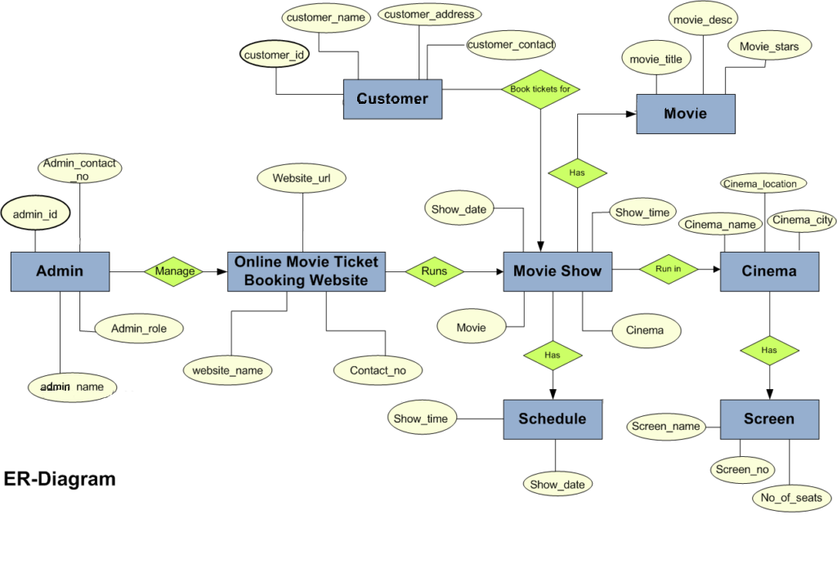

Slide 4
CUSTOMER
Book tickers for
MOVIE
has
ADMIN
manage
Online Movie Ticket
Booking Website
runs
MOVIE SHOW
Run in
CINEMA
has
has
SCHEDULE
SCREEN

Slide 5
Register
Login
Select movie
View movie details
Book movie tickets
USER
ADMIN
Add movie
Delete movie
Add movie
Log out

Slide 6
IMPLEMENTATION & MAINTENANCE: OBJECTIVE:
The objective of the Implementation Phase is: first to install the system in
the production environment and to bring it into operation; and second,
to ensure that the system, as developed:
>Satisfies the functional requirements
>Satisfies the business needs;
> Adheres to all mandates, physical constraints and service level
agreements.
>Operates as described in the User and Operator Manuals

Slide 7
FEATURES AVAILABLE:
Administrator:
Login
Add Movie Details
Remove Movie Details
Ticket management
User list management

Slide 8
FUTURE SCOPE OF IMPROVEMENT
More features can be added like
Allow customers to comment on movies.
Provide a list of upcoming movies.
SMS notification after successful seat reservation.
Encrypted Webpage to ensure customer privacy and transaction security.
More user friendly interface also in small screen devices.

Slide 9
CONCLUSION
This project has been developed successfully and the performance of the system has been found satisfactory.
Use of this interface administrator in having immediate alter about customize films, see income and left tickets.
User friendly Interface also for the admin to see who have bought the tickets and settled time for the movie .

Slide 10
THANK YOU!!!

